Slide 1

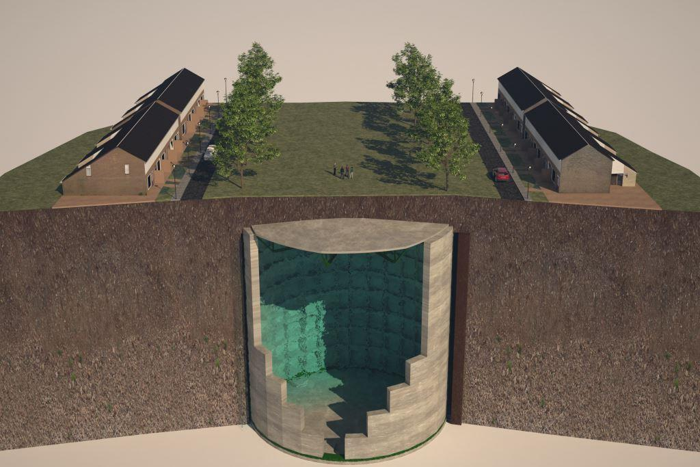
Ecovat
Team Members:
Ehsaan Al Assad 594688
Abdulhadi Bakhash 602016
Aliya
karl
Supervisor:
MES Big Data & Small Data M BDSD
Arnhem, June 2019

Slide 2
Content
1. INTRODUCTION
2. What is Ecovat ?
3. Gathering the Data
4. Data Preparation
5. Preparing the Data
6. Implementing the ML model (NN)
7. Results
8. Questions

Slide 3
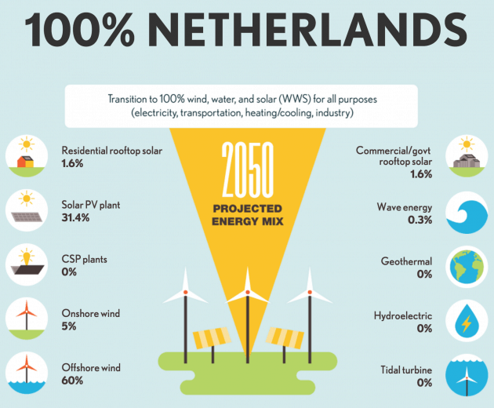
INTRODUCTION

Slide 4
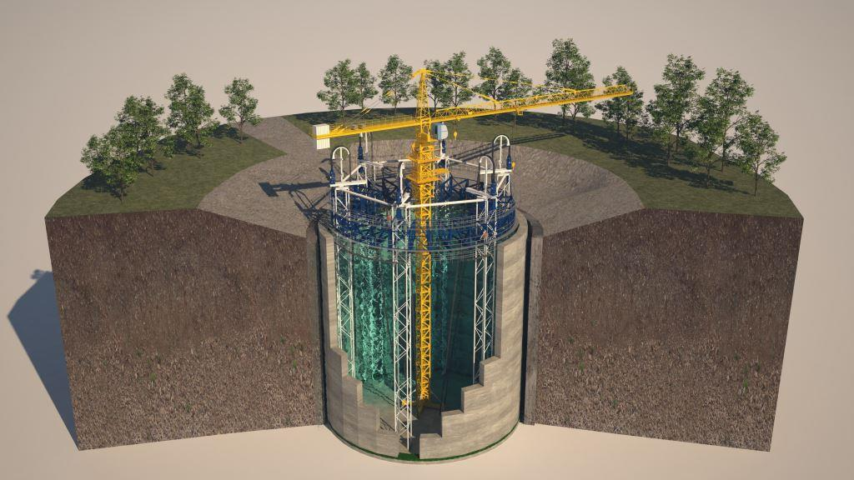
What is Ecovat ?

Slide 5
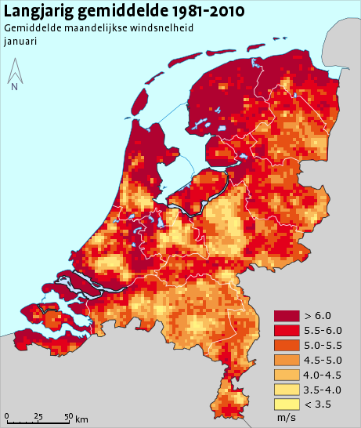
Gathering the Data
HAN
Heat pomp
central heating boiler
KNMI ()
-average wind speed
-Temperature
-Duration of the sunshine
-sum of the precipitation

Slide 6
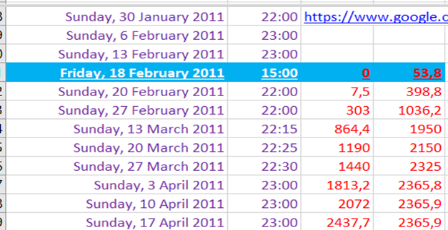
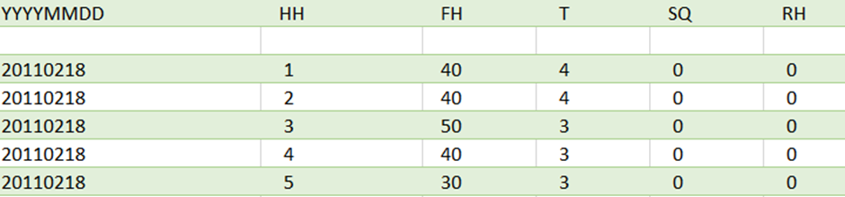
Data Preparation:
Data collection and preparation are the foundation for trusted ML models.
Once the data is collected, it’s time to assess the condition of it, including looking for trends, outliers, exceptions, incorrect, inconsistent, missing, or skewed information.
Because we have data from two different sources additional task should be implemented, such as: Find the optimal intersection or even the applicable one between the two datasets.
First we Determine the starting and the ending date of the measurements and the measurements intervals.
Data Consumption data set | KNMI Data set

Slide 7
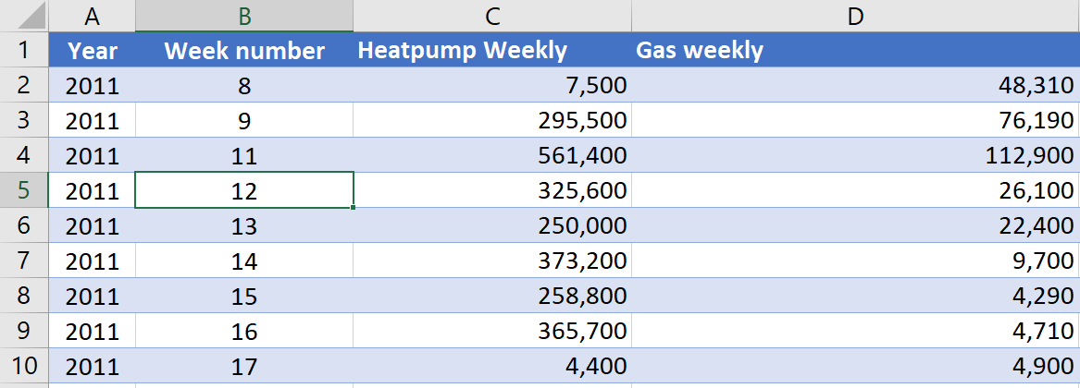
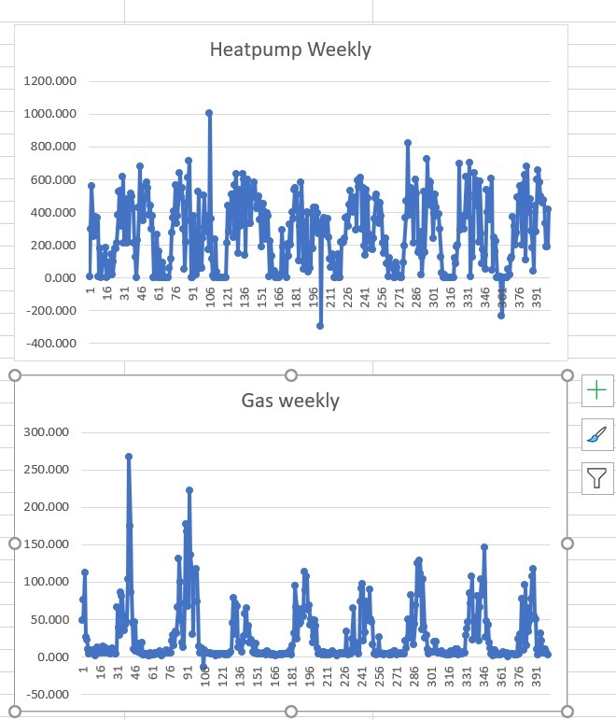
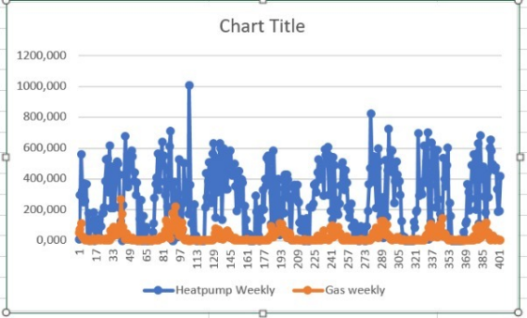
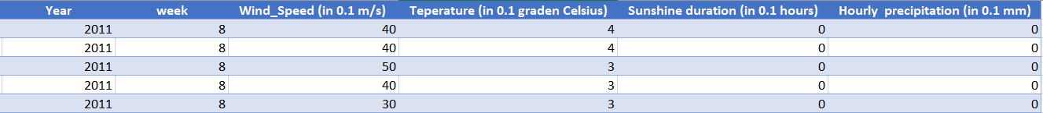
The Energy consumption interval measurements were not equal,
but a weekly interval will be so most convenience. But still in the
dataset there are some missing weeks and intersecting intervals,
so a lot of manual correction was done.
To prepare the KNMI dataset and fit it to the energy consumption dataset:
We change the unit in windspeed and temperature columns
We calculated the average and the sum on weekly bases for our four chosen columns.
We omitted manually all the weeks that have no equivalent in the energy consumption table and correct all the intersecting intervals, either by emitting or by adding them to the right week number.
We plotted the resulted dataset and omitted all the outliers’ values manually.

Slide 8
We combine the two tables together and created extra columns, such as total energy “Total energy” to get the following final table:
Now our data is ready for the ML model.

Slide 9
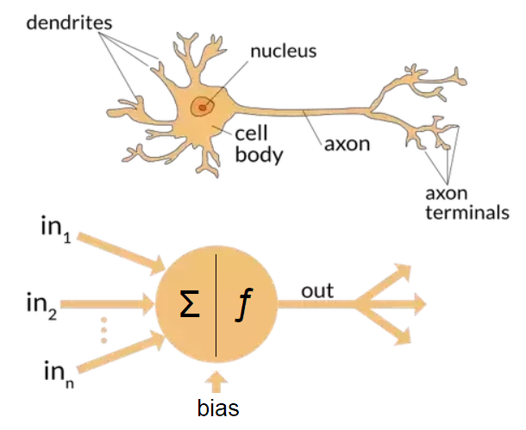
Structure of a neural network

Slide 10
Algorithm
Randomly initialise the weights
Implement forward propagation to get $h_{θ}\left(x_{i}\right)$ for any $x_{i}$
$$h_{θ}\left(x\right)=\frac{1}{1+e^{−θ^{T}x}}$$
Implement the cost function

Slide 11
Algorithm
Implement back propagation to compute partial derivatives
$$δ^{\left(L\right)}=a^{\left(i\right)}−y^{\left(i\right)}$$
Use gradient checking to confirm that your backpropagation works.
$$D_{ij}^{\left(l\right)}≔ \frac{1}{m}\left(∆_{ij}^{\left(l\right)}+λΘ_{ij}^{\left(l\right)}\right) if j≠0$$
$$D_{ij}^{\left(l\right)}≔ \frac{1}{m}∆_{ij}^{\left(l\right)} if j=0$$
Use gradient descent to minimise cost function with the weights in theta
$$\frac{∂}{∂Θ_{ij}}J\left(Θ\right)=D_{ij}^{\left(l\right)}$$
Notes:
The deltas multiplied with their respective activations and dividing by the number of samples, with regularisation gives the gradients

Slide 12
Adjustment of Data preparation
%Normalization and Scaling [data_table_norm, mu, sigma]=zscore(data_table);
% get the last 4 columns content and put them in a matrix which represents the input x = data_table_norm(:, 6:11); no_samples = size(x, 1);
% get the y’s y = data_table_norm(:, 3:5);

Slide 13
Change of error metrics
Original code was for binary classification problem.
We have a prediction problem.
New error metrics e.g.
mae (mean absolute error)
mare (mean absolute relative error)
mape (mean absolute percentage error)

Slide 14
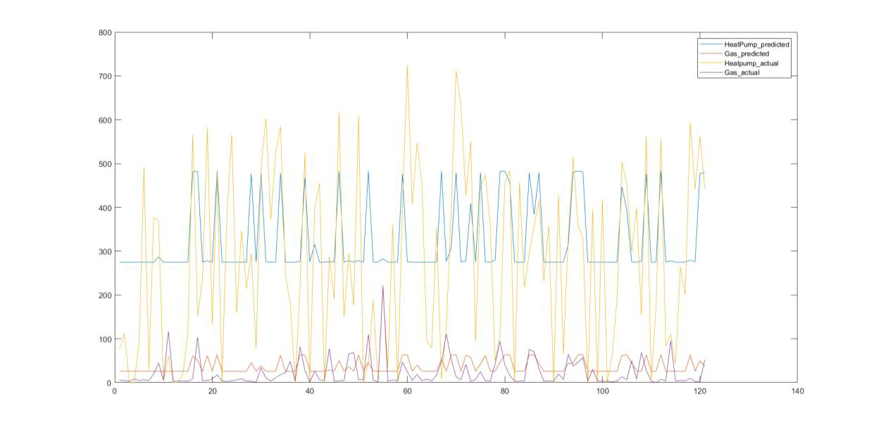
Results
NN output vs expected values – 50 hidden neurons

Slide 15
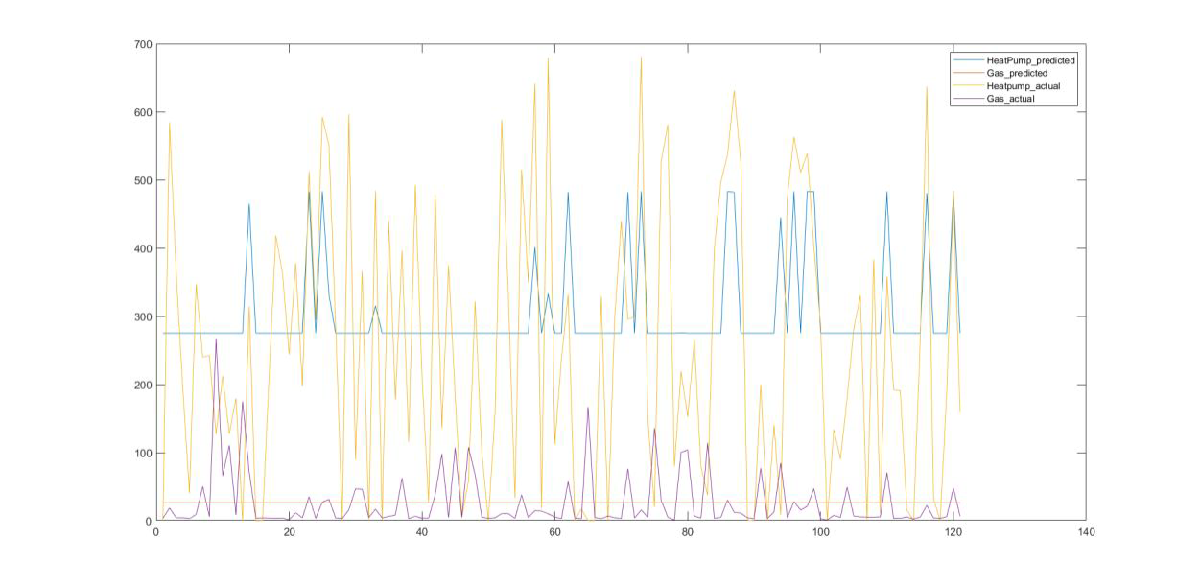
Results
NN output vs expected values - 150 hidden neurons

Slide 16
Conclustions
Heating demand cannot be predicted from this weather data with this type of prediction algorithm
Possible improvement on NN: use more hidden layers
Possible improvement on dataset:
Daily values
Bigger house with several households to mitigate effects of varying daily routines
Gather actual heat consumption data individually for hot water demand and heating

Slide 17
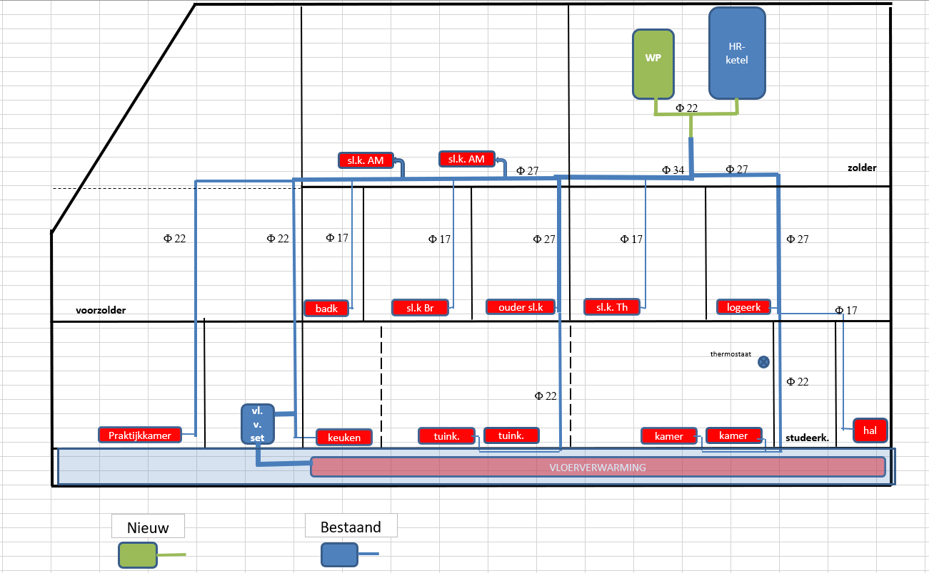
Origin of dataset

Slide 18
